Slide 1
Contextual Decision Processes
Machine Learning the Future, March 20
https://arxiv.org/abs/1610.09512

Slide 2
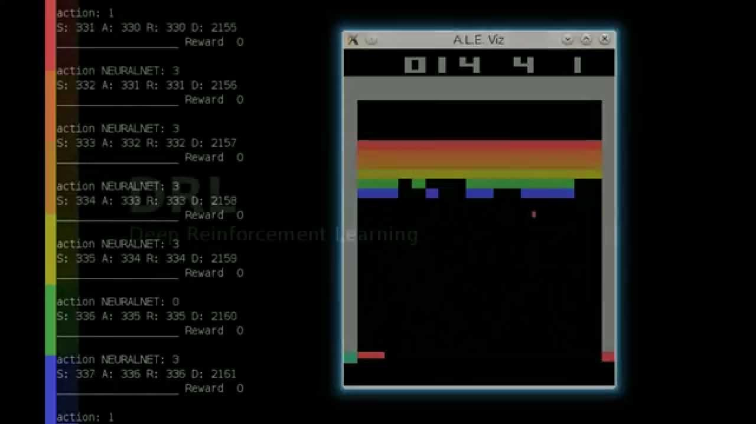
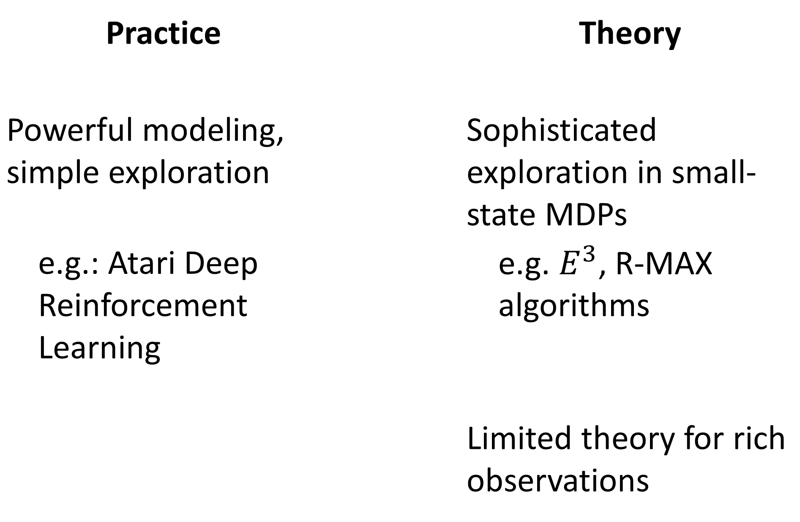
How to Learn?
Practice |  | Theory
Powerful modeling, simple exploration |  | Sophisticated exploration in small-state MDPs
e.g.: Atari Deep Reinforcement Learning |  | e.g. $E^{3}$, R-MAX algorithms
 |  | Limited theory for rich observations

Slide 3
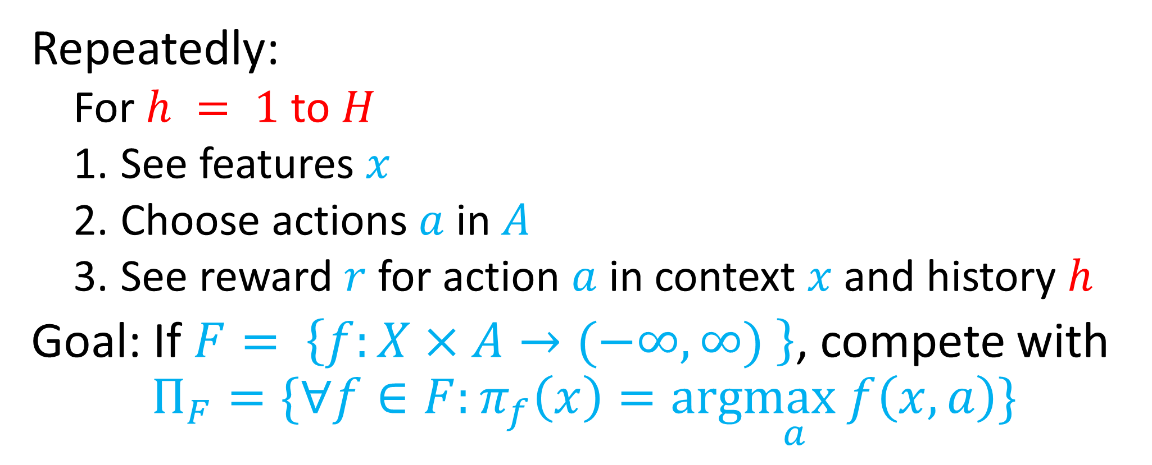
Contextual Decision Processes
Repeatedly:
  For $h = 1$ to $H$
  See features $x$
  Choose actions $a$ in $A$
  See reward $r$ for action $a$ in context $x$ and history $h$
Goal: If $F= \left\{f:X×A→(−∞,∞) \right\}$, compete with
$$Π_{F}=\{∀f∈F:π_{f}\left(x\right)=arg\max_{a}f\left(x,a\right)\}$$

Slide 4
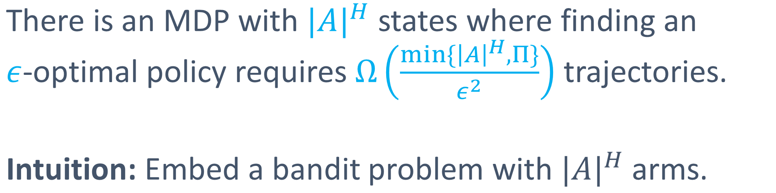
Bad News:
There is an MDP with ${|A|}^{H}$ states where finding an $ε$-optimal policy requires $Ω\left(\frac{min\{{\left|A\right|}^{H},Π\}}{ε^{2}}\right)$ trajectories.
Intuition: Embed a bandit problem with ${|A|}^{H}$ arms.
Lesson: Some notion of few-states required.

Slide 5
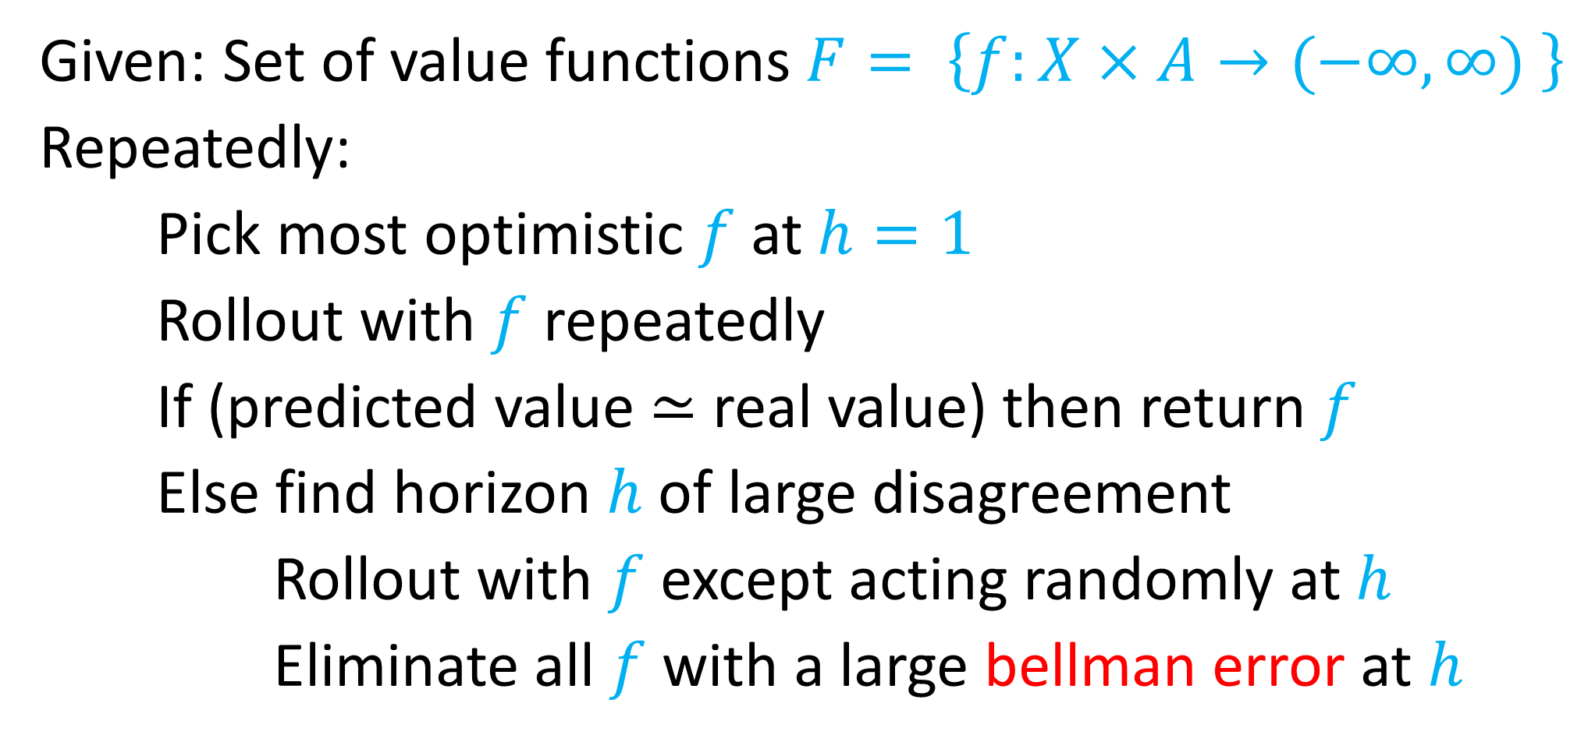
OLIVE: Optimism Led Iterative Value Elimination
Given: Set of value functions $F= \left\{f:X×A→(−∞,∞) \right\}$
Repeatedly:
Pick most optimistic $f$ at $h=1$
Rollout with $f$ repeatedly
If (predicted value $≃$ real value) then return $f$
Else find horizon $h$ of large disagreement
Rollout with $f$ except acting randomly at $h$
Eliminate all $f$ with a large bellman error at $h$

Slide 6
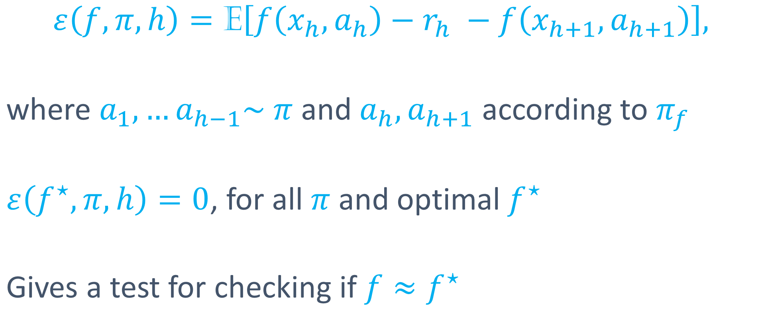
What is Bellman Error?
$$ε\left(f,π, h\right)=\text{E}\left[f\left(x_{h},a_{h}\right)−r_{h} −f\left(x_{h+1},a_{h+1}\right)\right],$$
where $a_{1}, …a_{h−1}\sim π$ and $a_{h}, a_{h+1}$ according to $π_{f}$
$ε\left(f^{⋆}, π, h\right)=0$, for all $π$ and optimal $f^{⋆}$
Gives a test for checking if $f≈f^{⋆}$

Slide 7
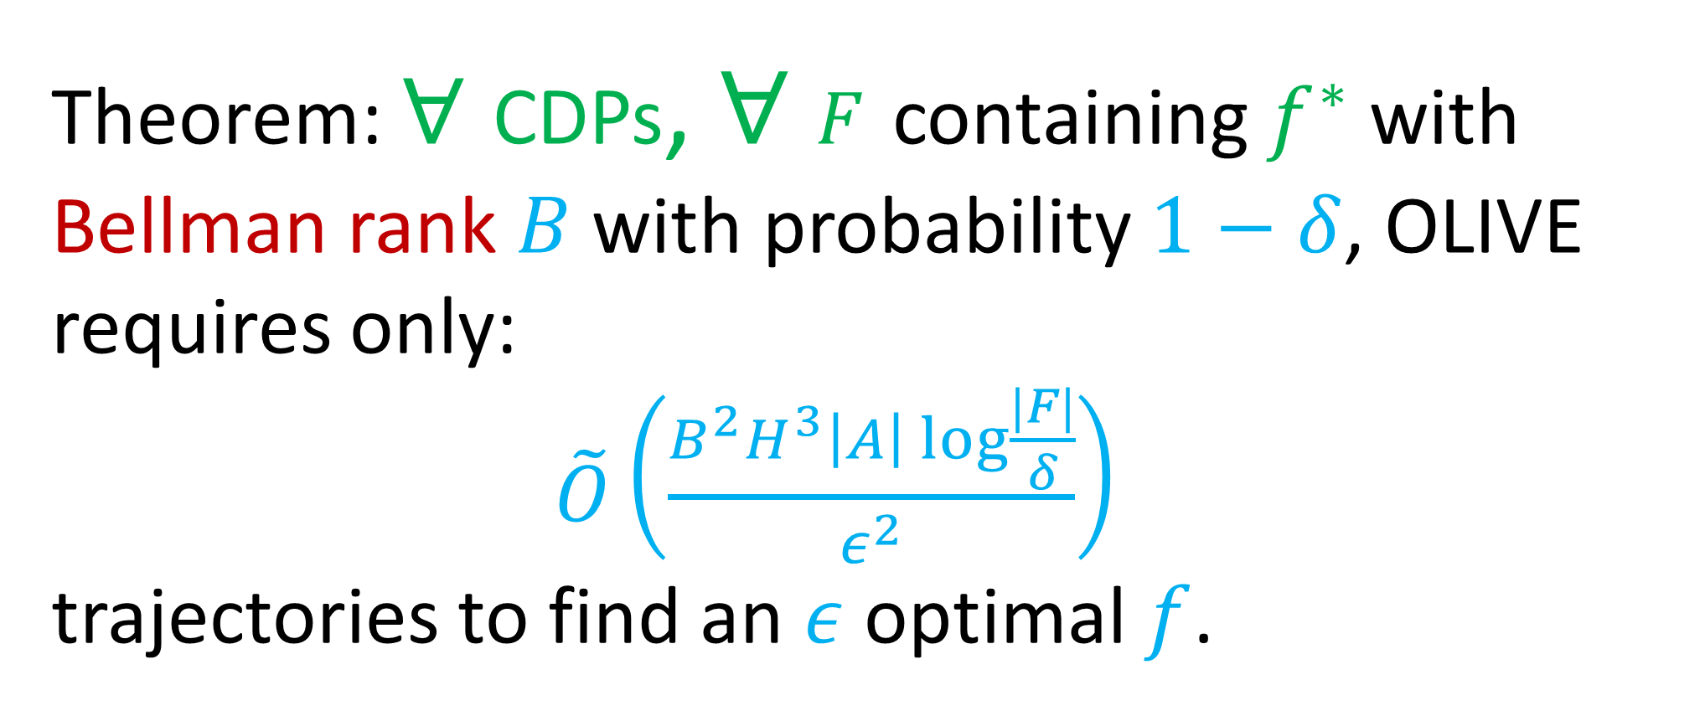
Theorem: $∀$ CDPs, $∀$ $F$ containing $f^{∗}$with Bellman rank $B$ with probability $1−δ$, OLIVE requires only:
$\tilde{O}\left(\frac{B^{2}H^{3}\left|A\right| log\frac{|F|}{δ}}{ε^{2}}\right)$
trajectories to find an $ε$ optimal $f$.

Slide 8
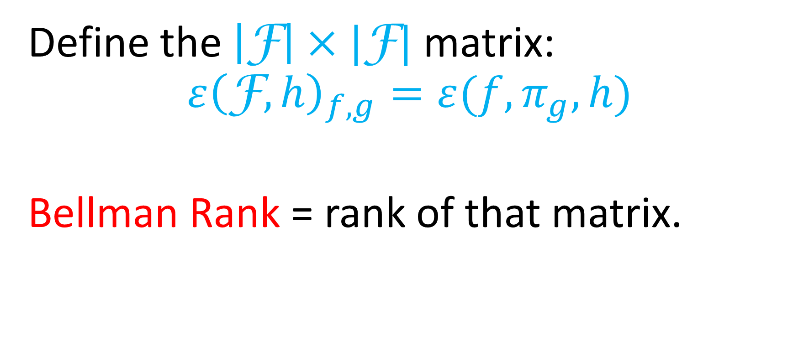
What is Bellman Rank?
Define the $\left|\text{F}\right|×|\text{F}|$ matrix:
$$ε{\left(\text{F}, h\right)}_{f,g}=ε(f, π_{g}, h)$$
Bellman Rank = rank of that matrix.

Slide 9
Bellman Rank bounded by “states” in simple models
Model | PAC Guarantees
Small-state MDPs | Known
Structured large-state MDPs | New
Reactive POMDPs | Extended
Reactive PSRs | New
LQR (continuous actions) | Known

Slide 10
A far from complete theory of RL
Computational Tractability?
World Models?
Options?
Safety?
…

