Slide 1














The Decision Service
Machine Learning the Future
March 20
https://arxiv.org/abs/1606.03966

Slide 2
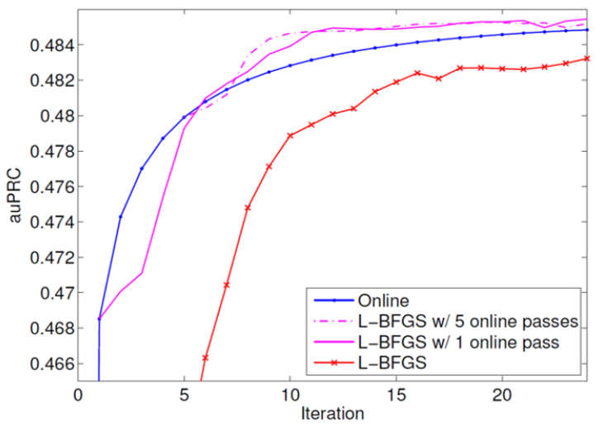
??

Slide 3


Slide 4
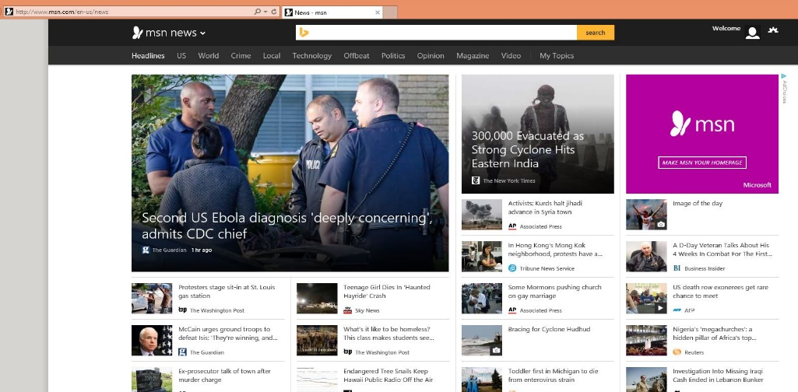
Ex: Which news?
Repeatedly:
Observe features of user+articles
Choose a news article.
Observe click-or-not
Goal: Maximize fraction of clicks

Slide 5
Many, many applications…
Which landing page?
When should your reboot?
Which character from an EEG?
…

Slide 6
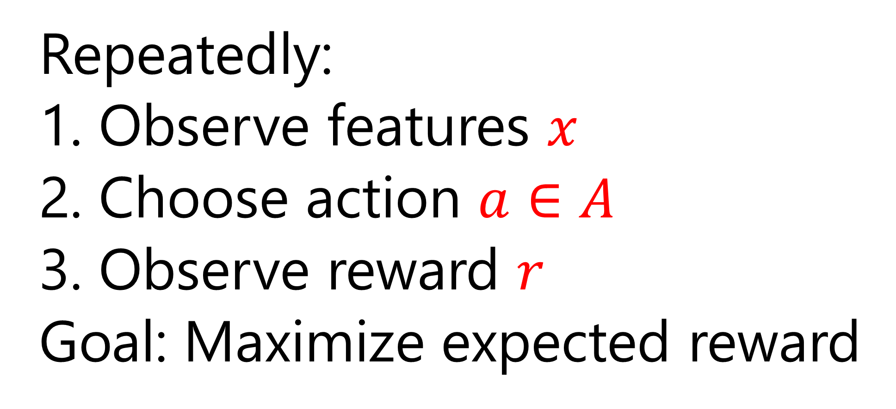
Contextual Bandits
Repeatedly:
Observe features $x$
Choose action $a∈A$
Observe reward $r$
Goal: Maximize expected reward

Slide 7
The History of Contextual Bandits
Statistically efficient algorithm [ACFS ‘95].
Reduce to SL [Z ’03, BL ’08, DLL ‘11]
Named, efficient [LZ ‘07]
Computation + Statistical optimality [DHKKLRZ ’11, AHKLLS ‘14]
Nonstationary policy evaluation [DELL ‘15]
Deployable [ABCHLLLMORSS ‘16]

Slide 8
What could possibly go wrong?
Different parts = Different people
Faulty logging
  Final action, not choice
  Just choice, not probability
  Features not logged
Runtime incompatible with ML
  Downstream overrides
  Using probability as feature
Explore
Log
Deploy
Learn

Slide 9


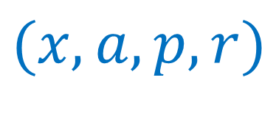
Decision Service
Policy $π$
context
Client Library
Online Learning
App
decision
Offline
Or Web API
Learning
reward
$$(x,a,p,k)$$
$\left(r,k\right)$
Join
Server
$$(x,a,p,r)$$

Slide 10
Decision Service
Policy $π$
Explore
context
Client Library
Online Learning
App
decision
Offline
Or Web API
Learning
reward
$$(x,a,p,k)$$
$\left(r,k\right)$
Join
Server
$$(x,a,p,r)$$

Slide 11
Decision Service
Policy $π$
context
Client Library
Online Learning
App
decision
Offline
Or Web API
Learning
reward
$$(x,a,p,k)$$
$\left(r,k\right)$
Join
Server
$$(x,a,p,r)$$
Log

Slide 12
Decision Service
Policy $π$
Learn
context
Client Library
Online Learning
App
decision
Offline
Or Web API
Learning
reward
$$(x,a,p,k)$$
$\left(r,k\right)$
Join
Server
$$(x,a,p,r)$$

Slide 13
Decision Service
Deploy
Policy $π$
context
Client Library
Online Learning
App
decision
Offline
Or Web API
Learning
reward
$$(x,a,p,k)$$
$\left(r,k\right)$
Join
Server
$$(x,a,p,r)$$

Slide 14
Decision Service
Policy $π$
context
Client Library
Online Learning
Offline Learn
App
decision
Offline
Or Web API
Learning
reward
$$(x,a,p,k)$$
$\left(r,k\right)$
Join
Server
$$(x,a,p,r)$$
Data

Slide 15
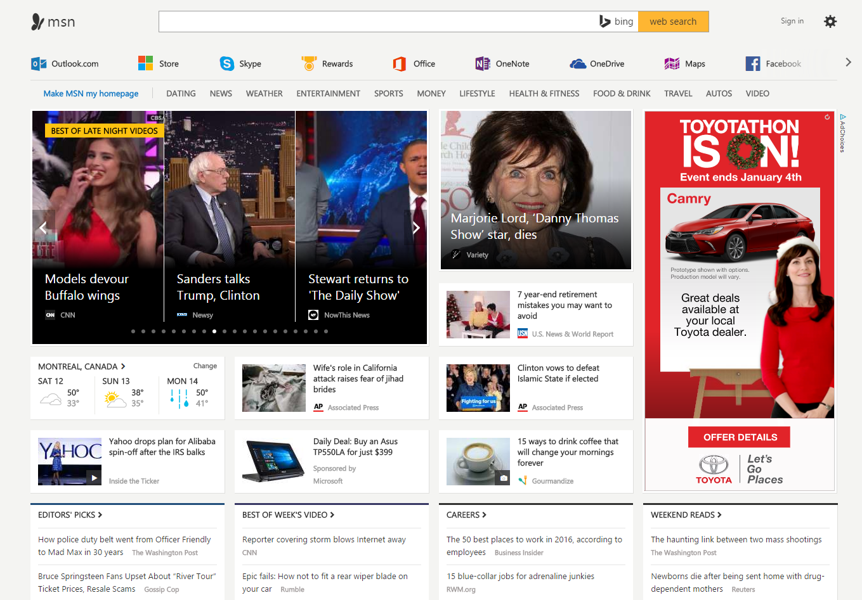

Slide 16



MSN Results
10s of millions of users
5 minute model update frequency
> 25% increase in clicks
(without much tuning)
…

Slide 17
Keys to Success
Contextual Bandits: Bias kills
Data Lifecycle support: Bugs kill
Reproducibility: Bugs kill
Online Learning: Nonstationarity!

Slide 18
Deployable Decision Service
http://aka.ms/mwt
http://arxiv.org/abs/1606.03966
http://hunch.net/~vw

Slide 19
Really New Stuff
Javascript interface
Hosted decision service (http://ds.microsoft.com)
“Cognitive Services” https://www.microsoft.com/cognitive-services as featurization backends

